Slide 1









GOLD SPONSORS
SILVER SPONSORS
BRONZE SPONSOR
STRATEGIC PARTNER

Slide 2
SQL vs ORM or why should I care about SQL, if I have ORM?
Denis Reznik

Slide 3
About me
Denis Reznik, Kyiv, Ukraine
2002 – Started education in a university
2006 – Started working as a software developer
2007 – Graduated from a university
2006 – 2015 – Worked in software development companies and improve databases (SQL Server) knowledge
2015 – Switched primary responsibility from software development to databases
Nowadays – Work as a Data Architect at Intapp, Inc.
2016 – Came to SQL Day for the first time
3 |

Slide 4
Agenda
.Net ORM History (which I remember)
Simple Queries
Column List
Lazy Load
Data Types
Data Modification
Complex Query
Parameter Sniffing
The Main Thing to Keep in Mind

Slide 5
ORM History which I remember
ADO.NET
Data Sets (not too bad)
LLBL Gen, NHibernate (better than data sets)
LINQ to SQL (Awesome!)
Entity Framework. Should be even more awesome!
Entity Framework is more powerful than L2S
Entity Framework Code First
Entity Framework is no so good, so what?

Slide 6
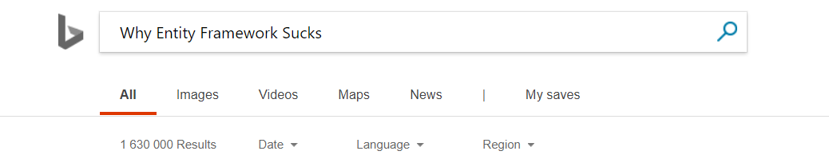
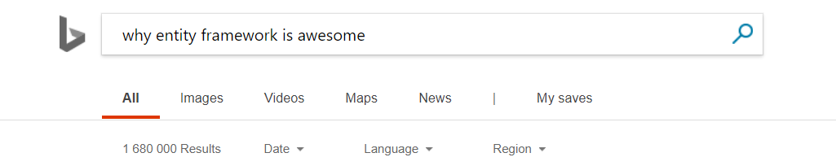
Entity Framework Index (by Bing)

Slide 7

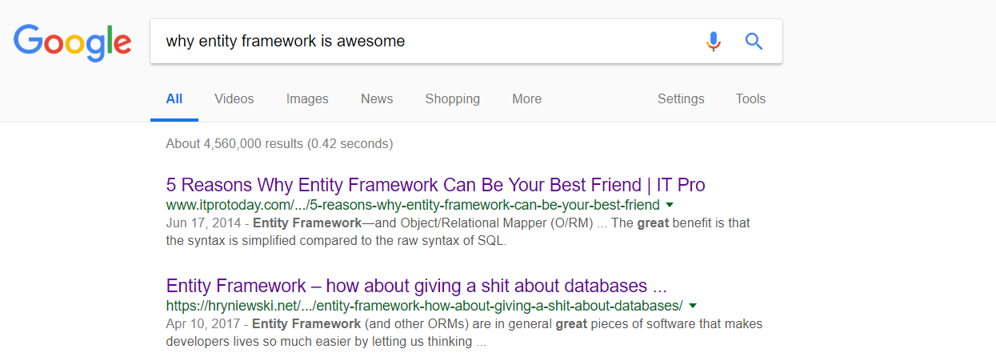
Entity Framework Index

Slide 8
Simple Query

Slide 9
DEMO
Simple Query

Slide 10
DEMO
Column List

Slide 11
Lazy Load

Slide 12
Index Seek
SELECT * FROM Users
WHERE Id = 523
1 .. 1M
1 .. 2K
2K+1 .. 4K
…
1M-2K .. 1M
1 .. 300
301 .. 800
801 .. 1,5K
1,5K+1 .. 2K
…

Slide 13
Index Scan
SELECT * FROM Users
1 .. 1M
1 .. 2K
2K+1 .. 4K
…
1M-2K .. 1M
1 .. 300
301 .. 800
801 .. 1,5K
1,5K+1 .. 2K
…

Slide 14
DEMO
Lazy Load

Slide 15
Data Types

Slide 16
DEMO
Data Types

Slide 17
Data Modification

Slide 18
DEMO
Data Modification

Slide 19
Complex Query

Slide 20
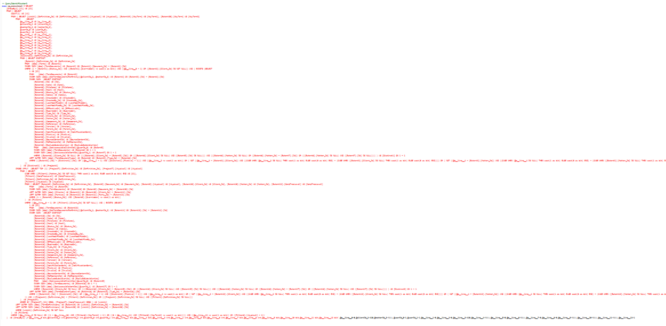
What does it mean “Complex Query” ?

Slide 21
DEMO
Complex Query

Slide 22
Parameter Sniffing

Slide 23
Parameter Sniffing - Stored Procedure
Query Processor
EXEC ReportCheckSecurityRequest @UserId = 1
EXEC ReportCheckSecurityRequest @UserId = 22
SQL Server Cache
Procedure cache
Procedure cache
Query executes using the query plan created for
@UserId = 1
Plan created and cached for the
@UserId = 1

Slide 24
Parameter Sniffing – Parametrized Query
Query Processor
SELECT * FROM Users WHERE Id = @Id
sp_executesql N'SELECT * FROM Users WHERE Id = @Id', N'@Id int', 1
SELECT * FROM Users WHERE Id = @Id
sp_executesql N'SELECT * FROM Users WHERE Id = @Id', N'@Id int', 22
SQL Server Cache
Procedure cache
Procedure cache
Plan created and cached for the
@Id = 1
Query executes using the query plan created for
@Id = 1

Slide 25
Dynamic SQL – Multiple Plans
Query Processor
SELECT * FROM Users WHERE Id = 1
SELECT * FROM Users WHERE Id = 22
SQL Server Cache
SELECT * FROM Users WHERE Id = 1
Procedure cache
Procedure cache
Procedure cache
Query executed using the query plan, created for the first query.
New query plan created and cached. Query executed using newly created plan.
New query plan again created and cached. Query executed using newly created plan.

Slide 26
DEMO
Parameter Sniffing

Slide 27
The Main Thing to Keep in Mind

Slide 28
Life without ORM (Entity Framework)
Some Magic
Query
Result Set
28 |

Slide 29
Life with ORM (Entity Framework)
Some Magic
Application Code
SQL Query
Some Magic
Result Set
29 |

Slide 30
Life without micro-ORM (Dapper)
Some Magic
Query
Result Set
30 |

Slide 31
Summary
ORM is really a nice thing
But it still requires strong SQL background
Databases and ORMs are changing very fast
Few Advices
Sometimes check the generated SQL and its query plan
For complex queries consider raw SQL anyway
Consider using Dapper
Invest your time to learn database internals
There is no Silver Bullet

Slide 32
Thank you!
Denis Reznik
Twitter: @denisreznik
Email: denisreznik@gmail.com
Blog: http://reznik.uneta.com.ua
Facebook: https://www.facebook.com/denis.reznik.5
LinkedIn: http://ua.linkedin.com/pub/denis-reznik/3/502/234

